Slide 1
AutoLayout
Frame/bounds, constraints, anchors

Slide 2
Frame Bounds Transform AutoresizingMask

Slide 3
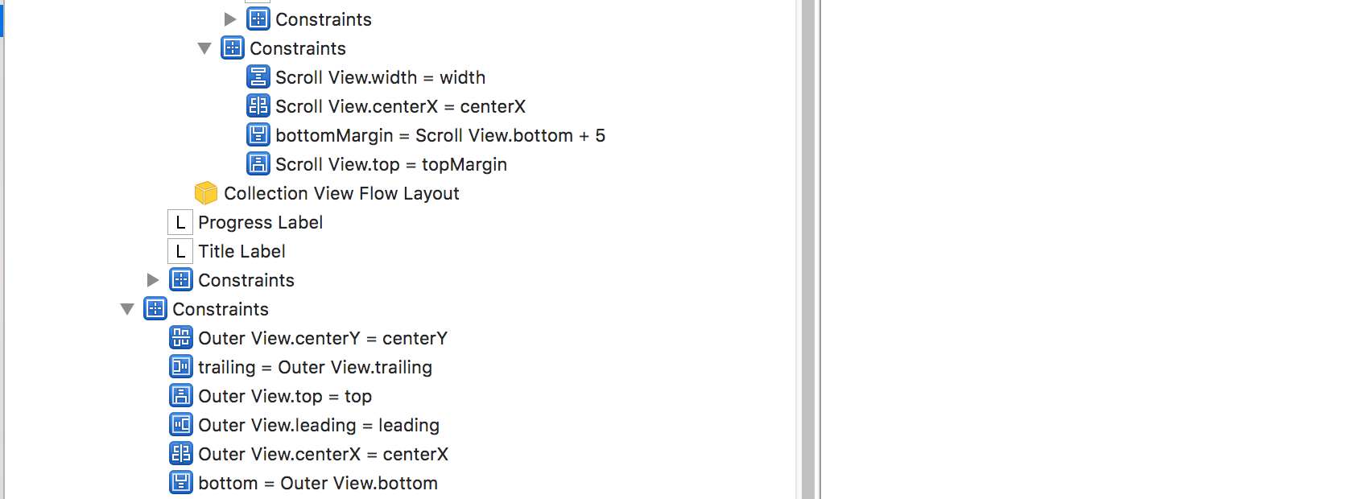
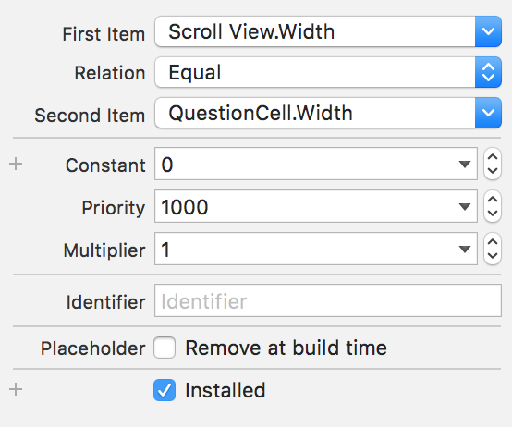
AutoLayout

Slide 4
What do I need to know?
UIView properties
Interface builder & API
Uiviewcontroller lifecycle
animations

Slide 5
UIView properties
Constraints
Content size
Compression
Hugging
translatesAutoresizingMaskIntoConstraints

Slide 6
Constraints
Layout - nslayoutconstraint
Content - NSContentSizeLayoutConstraint
Autosizing - NSAutoresizingMaskLayoutConstraint

Slide 7
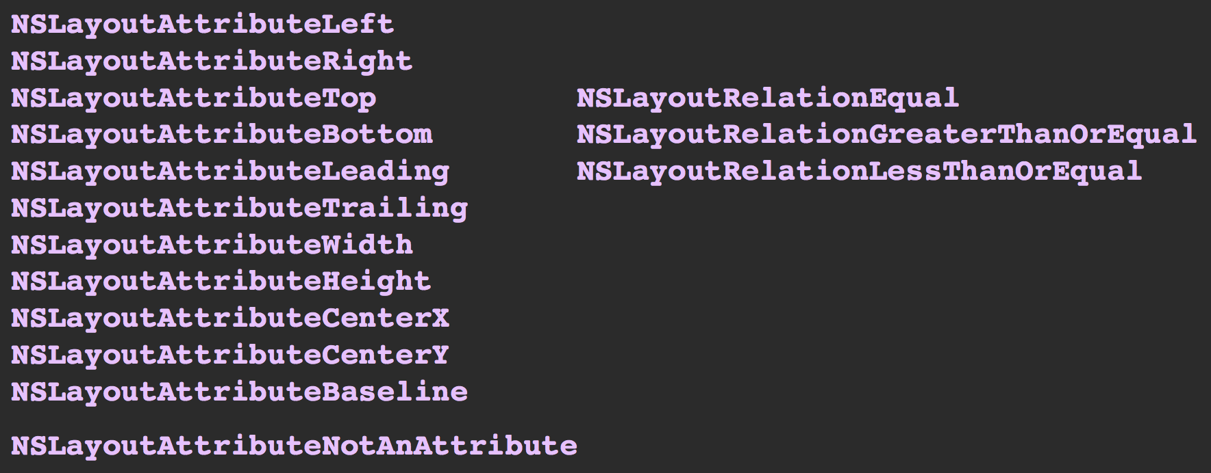
Constraints

Slide 8
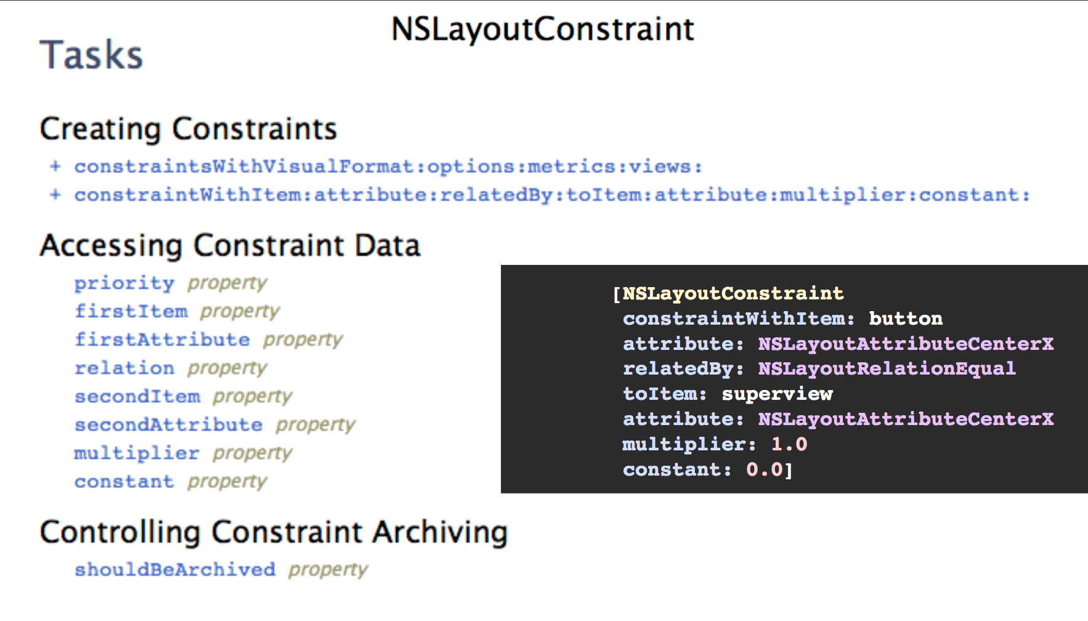
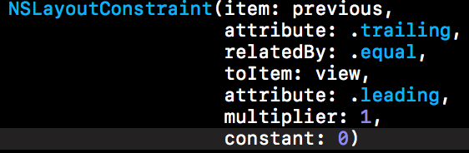
Constraints

Slide 9
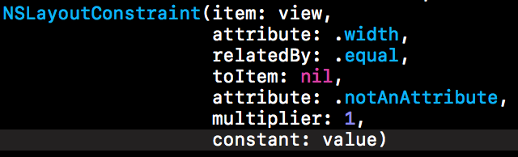
Constraints

Slide 10
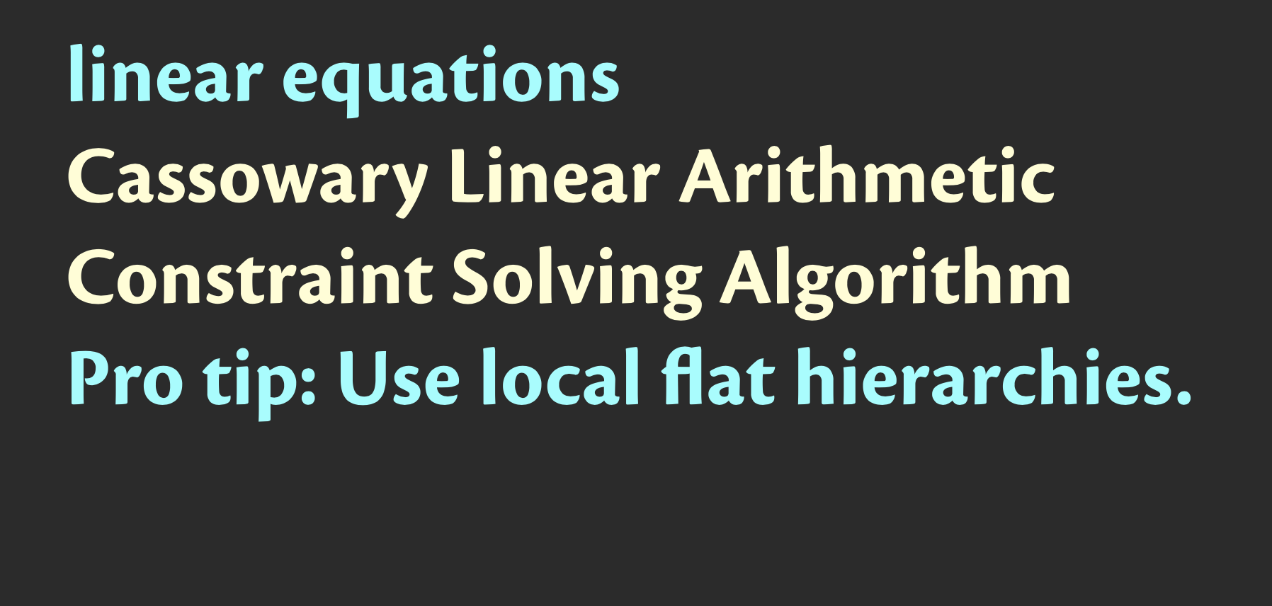
Constraints

Slide 11
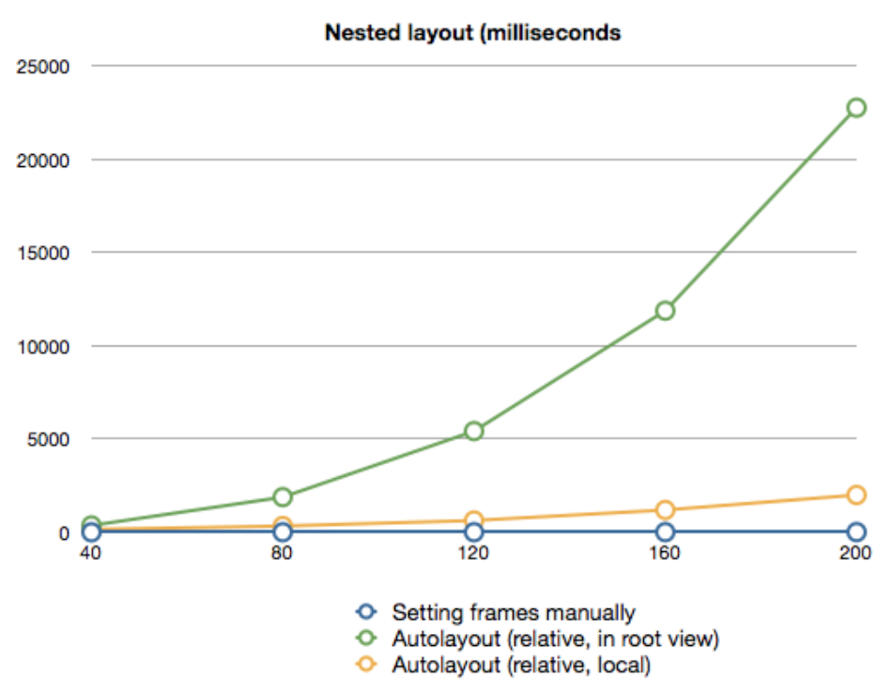
Constraints

Slide 12
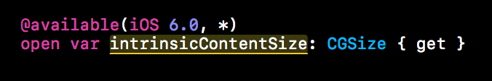
instrinsicContentSize
Suggested size for the view

Slide 13
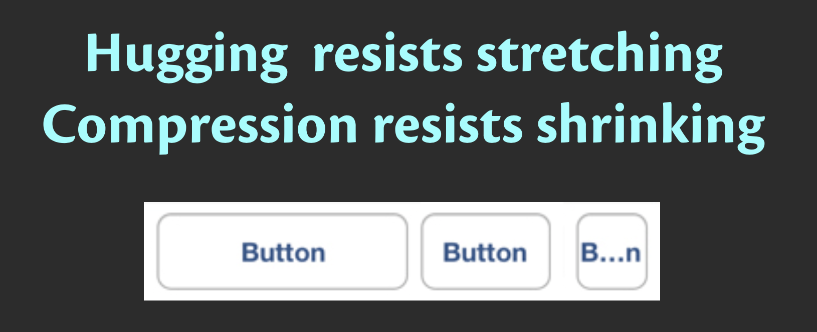
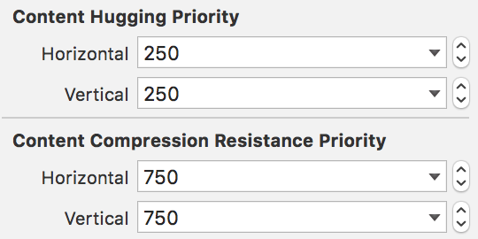
Hug & compress

Slide 14
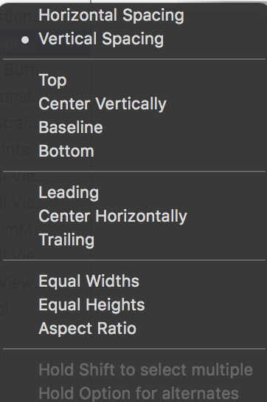
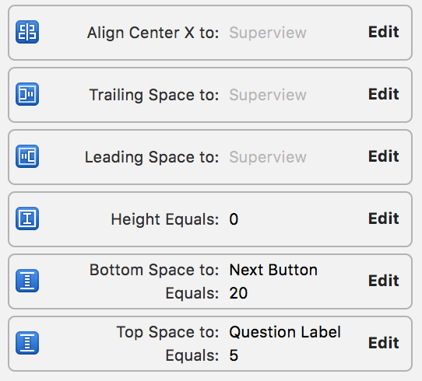
Interface Builder

Slide 15
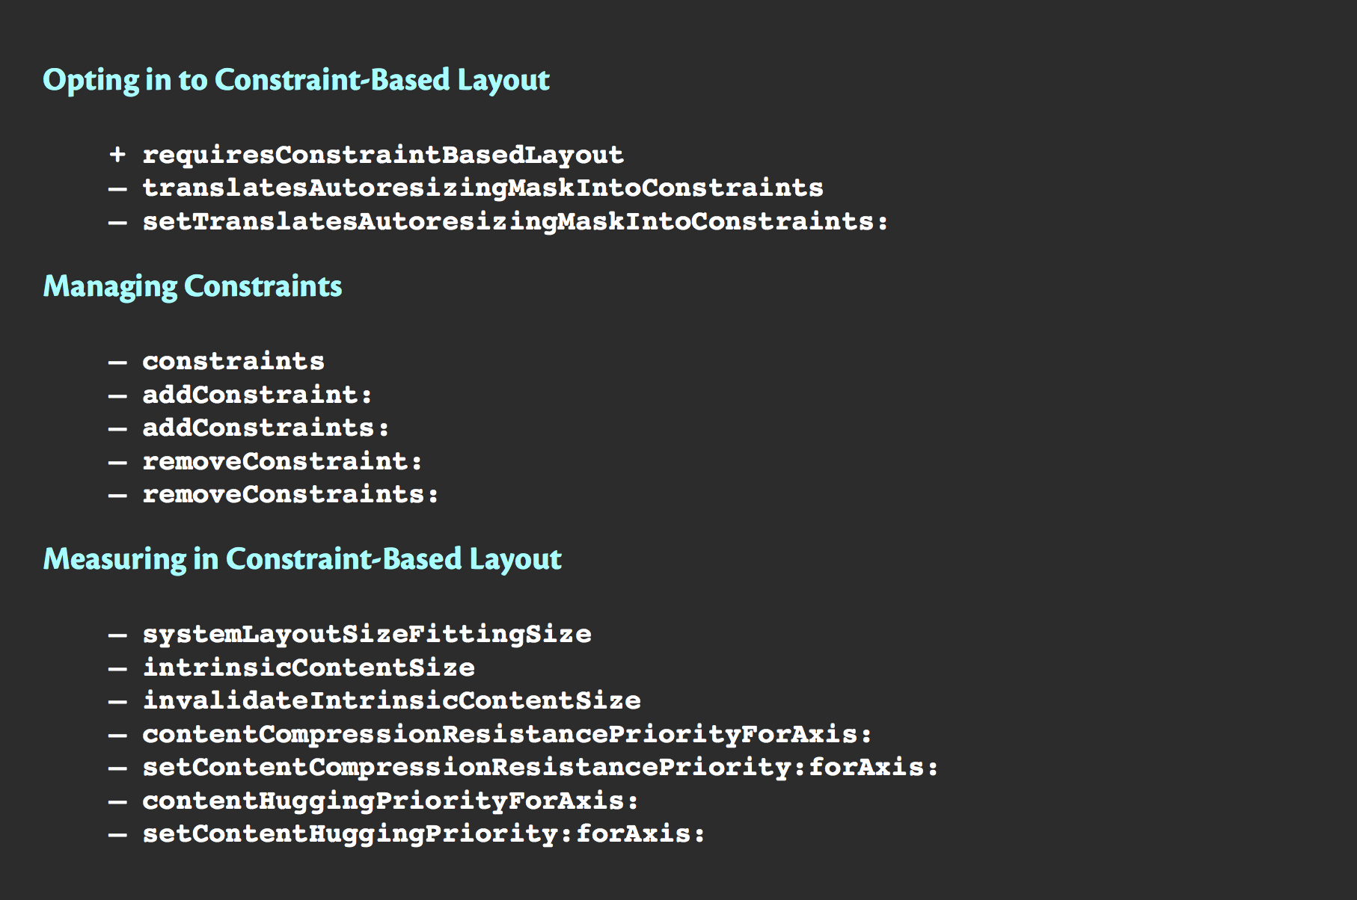
UIView API

Slide 16
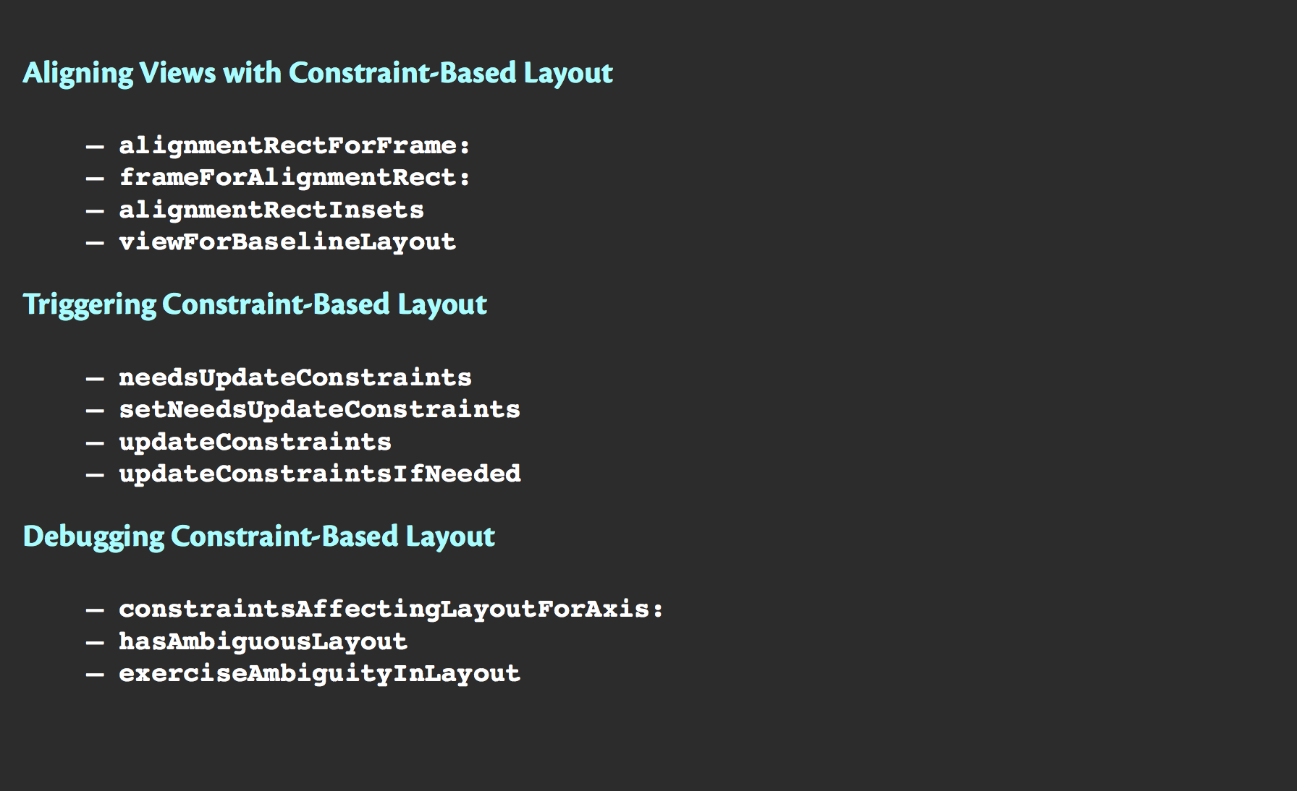
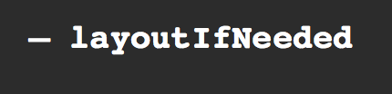
UIView API

Slide 17
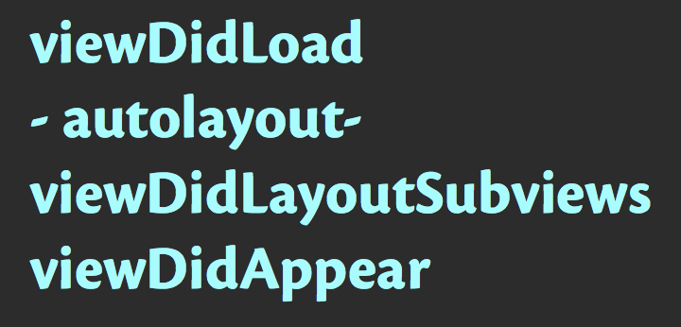
UIViewController

Slide 18

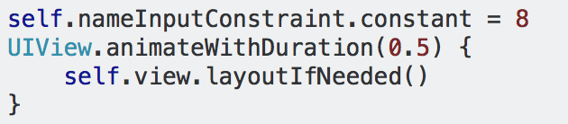
Animation

Slide 19
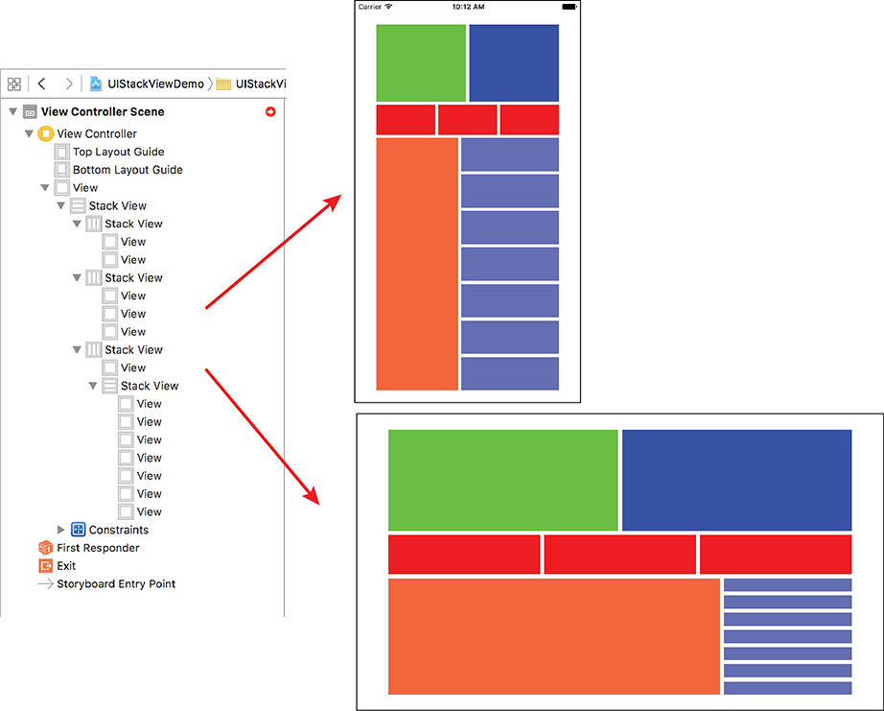
UIStackView

Slide 20
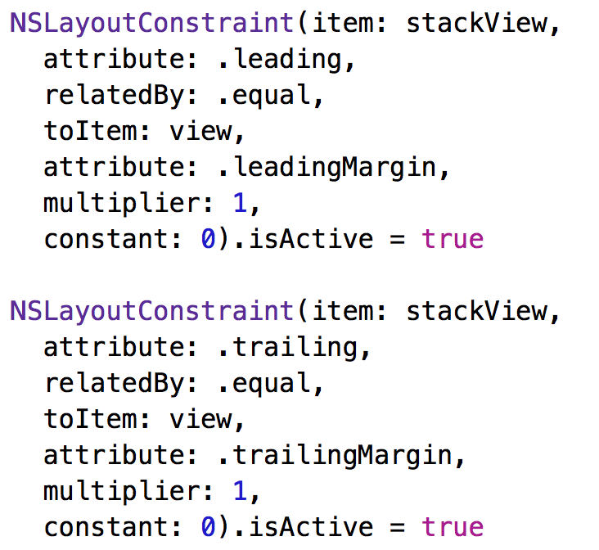
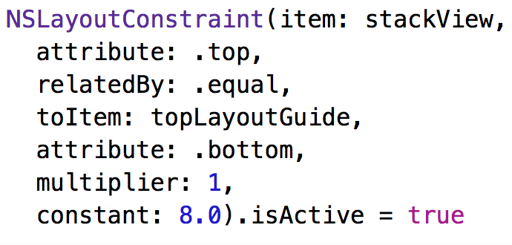
Layout Anchors

Slide 21
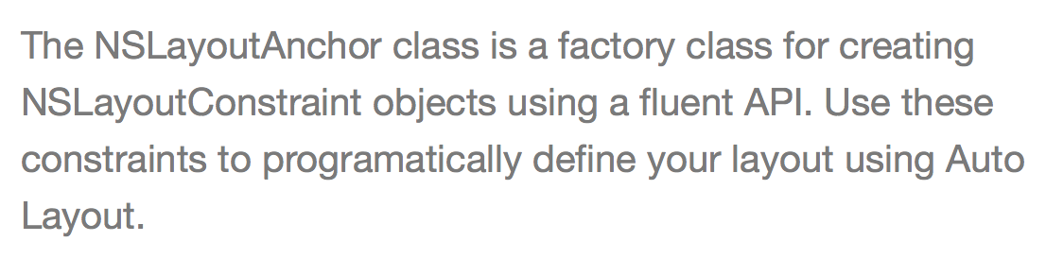
Layout Anchors

Slide 22
Layout Anchors

Slide 23
Layout Anchor + UIStackView

